Slide 1
Computational Concept and Cognitive Architecture of Artificial Psyche
Anton Kolonin, Ph.D.
Novosibirsk State University https:/nsu.ru
Russian AGI Community https://agirussia.org
Aigents https://aigents.com

Slide 2
General Intelligence:
Reaching complex goals in different complex environments, using limited resources under uncertainty
(Ben Goertzel + Pei Wang + Shane Legg + Marcus Hutter)
Intelligent
Agent

Slide 3
The psyche /ˈsaɪki/ is currently used to describe the totality of the human mind, conscious and
unconscious.
https://en.wikipedia.org/wiki/Psyche
Psyche
Unconscious
Conscious

Slide 4
Computational Concept and Cognitive Architecture of Artificial Psyche
System = Intelligent agent
Psyche = Operating system
Intelligence = Decision making system
Subconsciousness
(Intuition)
“System 1”
(“Fast”)
Consciousness
(Reasoning)
“System 2”
(“Slow”)
Emotions
Motivation
Expectations
Space of states
Sensations
Needs
Actions
Decisions
Perceptions
Sensors
Actuators
Anton Kolonin & Vladimir Kryukov,
Computational Concept of the Psyche,
Neuroinformatics-2025
https://arxiv.org/pdf/2509.07009
Sensations
Actions
Outer world = Operational environment

Slide 5


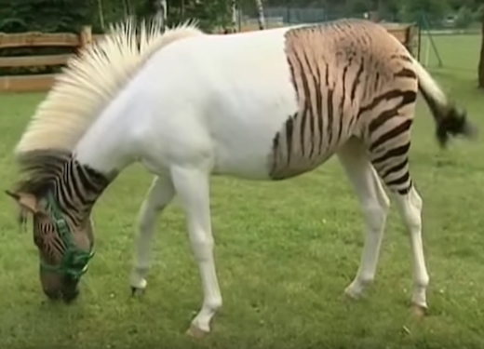
Neuro-Symbolic Integration for Interpretable AI
Hooves
Tail
White
Black
Brown
Red
0.5
0.5
0.5
0.5
1.0
0.5
0.5
0.5
0.5
Σ
Σ
Σ
Explain
AND
AND
1.0
1.0
1.0
1.0
1.0
Σ
Σ
OR
Transfer
0.5
0.5
0.5
0.5
Σ
AND
“System 1”
“System 2”
(Hooves AND Tail) AND NOT Red
((White and Black) OR Brown)
=> Horse
https://www.springerprofessional.de/neuro-symbolic-architecture-for-experiential-learning-in-discret/20008336

Slide 6
Functional equivalence of tensor and graph (symbolic) models
Strokes, letters, words and phrases
Words
Sentences
strokes , letters words and phrases
Letters
w o r d s
Strokes
\ /
Pedro Domingos, Tensor Logic: The Language of AI https://arxiv.org/pdf/2510.12269

Slide 7

Functional equivalence of tensor and (symbolic) graph models
Truth-Value Tensor
(NARS/PLN)
Numerical Tensor
(ANN/Bayesian Logic)
Boolean Tensor
(Boolean Logic)
Property
Property
Property
0.0123456
=750/60750
striped
striped
~0.01
striped
“False”
horse
horse
horse
Subject
Subject
Subject
Life-long
learning?
Pedro Domingos, Tensor Logic: The Language of AI https://arxiv.org/pdf/2510.12269

Slide 8
Computational Concept and Cognitive Architecture of Artificial Psyche
Psyche = Operating system
Intelligence = Decision making system
Models s (“invariants”) of states with utilities U and probabilities P of transitions
U({sτ}τ∈{-Τ,-1}​,s’0) = L( x⋅(yt - yt-1), (s’t - st), E(at-1)) s’t=argmaxs(U({sτ}τ∈{t-Τ,t-1}​,s’t),P({sτ}τ∈{t-Τ,t-1}​,s’t))
Experiential learning
Decision making
Space of states and episodic memory (“precedents”)
State st-1 (past)
State st (present)
State st+1 (future)
Reality
(“fact”) st-1
Expectation
(“plan”) s’t
Reality
(“fact”) st
Expectation
(“plan”) s’t+1
Sensations
ft-1
Ощущения
f’t
Sensations
ft
Sensations
f’t+1
Sensations
f’t
Needs
yt-1
Потребности
x’t
Needs
yt
Needs
y’t+1
Needs
y’t
Actions
at-1
Действия
a’t
Actions
at
Actions
a’t+1
Actions
a’t
Anton Kolonin & Vladimir Kryukov,
Computational Concept of the Psyche,
Neuroinformatics-2025
https://arxiv.org/pdf/2509.07009
Decisions
Perceptions
Actuators
Sensors
x⋅yt — “motivation vector”
V. F. Petrenko and A. P. Suprun, “Goal oriented systems, evolution, and the subjective aspect in systemology,” Tr. Inst. Sistem. Analiza RAN 62 (1) (2012)

Slide 9
Computational Concept and Cognitive Architecture of Artificial Psyche
Energy-efficiency
of a
Psyche = Operating system
Optimal decision and expectation of s
Predictability
of s
Intelligence = Decision making system
Expected
utility of s
Models s (“invariants”) of states with utilities U and probabilities P of transitions
U({sτ}τ∈{-Τ,-1}​,s’0) = L( x⋅(yt - yt-1), (s’t - st), E(at-1)) s’t=argmaxs(U({sτ}τ∈{t-Τ,t-1}​,s’t),P({sτ}τ∈{t-Τ,t-1}​,s’t))
Experiential learning
Decision making
Expected probability
of s
Satisfaction
of y
Space of states and episodic memory (“precedents”)
State st-1 (past)
State st (present)
State st+1 (future)
Reality
(“fact”) st-1
Expectation
(“plan”) s’t
Reality
(“fact”) st
Expectation
(“plan”) s’t+1
Sensations
ft-1
Ощущения
f’t
Sensations
ft
Sensations
f’t+1
Sensations
f’t
Needs
yt-1
Потребности
x’t
Needs
yt
Needs
y’t+1
Needs
y’t
Actions
at-1
Действия
a’t
Actions
at
Actions
a’t+1
Actions
a’t
Anton Kolonin & Vladimir Kryukov,
Computational Concept of the Psyche,
Neuroinformatics-2025
https://arxiv.org/pdf/2509.07009
Decisions
Perceptions
Actuators
Sensors
x⋅yt — “motivation vector”
V. F. Petrenko and A. P. Suprun, “Goal oriented systems, evolution, and the subjective aspect in systemology,” Tr. Inst. Sistem. Analiza RAN 62 (1) (2012)

Slide 10
Decision making as operational risk management
s’t+1
st
s't+1
U
P
∑U*P
s’t=argmaxs(U,P)
a’
y’
f’
a’t=argmaxa(U,P)
s1
s’2
a’1
y’1
...
1.0
0.5
0.7
s1
s'3
a’1
y’2
...
0.4
0.5
s1
s’4
a’2
y’3
...
1.0
0.8
0.8
s1
s’5
a’2
y’4
...
0.0
0.2
a’1
a’2
a’3
a’4
s’2
s’4
s’6
s’7
s1
s’6
a’3
y’5
...
0.6
1.0
0.6
* Tversky & Kahneman: most people choose a’3 и s’6
(“smaller profit with
greater reliability”)
s1
s’7
a'4
y’6
...
0.0
1.0
0.0

Slide 11
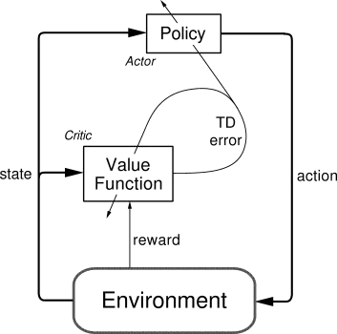
Implementation options
1) Reinforcement learning based on “actor-critic” model
https://medium.com/intro-to-artificial-intelligence/the-actor-critic-reinforcement-learning-algorithm-c8095a655c14

Slide 12
Implementation options
3) Cognitive architecture based on LLM and (active) GraphRAG
LLM
Tools
GraphRAG
Reasoner
Model Data
Response
Knowledge Graph
Model Parameters
Goals
Interaction Logs (RLHF)
Domain Knowledge
Request
Setup
Leonie Monigatti, "The Evolution from RAG to Agentic RAG to Agent Memory", November 3, 2025
https://www.leoniemonigatti.com/blog/from-rag-to-agent-memory.html

Slide 13
Implementation options
2) Cognitive architecture based on probabilistic logic (“Discovery”)
Motivation-
Request to achieve a goal G
Afferentation about situation
P₁,…,P_{m}
Evgenii Vityaev, Alexander Demin: Adaptive Control of Modular Robots // Conference Paper in Advances in Intelligent Systems and Computing, Conference: First International Early Research Career Enhancement School on Biologically Inspired Cognitive Architectures, Springer, August 2018
Evgenii E. Vityaev: Purposefulness as a Principle of Brain Activity // Anticipation: Learning from the Past, (ed.) M. Nadin. Cognitive Systems Monographs, V.25, Chapter No.: 13. Springer, 2015, pp. 231-254.
Витяев Е.Е. Логика работы мозга. Подходы к моделированию мышления. (сборник под ред. д.ф.-м.н. В.Г. Редько). УРСС Эдиториал, Москва, 2014г., стр. 120-153.
AFFERENT
SYNTHESIS
Set PR of rules ⟨P₁,…,P_{k}, A⟩ → G that forecast achievement of the goal G in situation P₁,…,P_{m} if fulfil A
and subgoals P₁,…, P_{n}
Forecast for result G
RESULT R
ACTIONS
RESULTS
ACCEPTOR
Anticipation of result G
RESULT
EVALUATION G ≈ R
Reinforcement/ punishment
Forecast for goal G
achievement
DECISION MAKING
Selection of actions A and subgoals P₁,…, P_{n}, providing maximum probability of the goal G achievement
RESULT R
Backward
afferentation
RESULTS R₁,…,R_{n}
Subgoals P₁,…, P_{n}
Actions A
Forecast for subgoals P₁,…, P_{n}

Slide 14
Implementation options
4) Cognitive architecture of value-based experiential learning
Agent
Supervisor
Compressor
Predicates Graph
Base Values
goal(be(happy))
Outer environment
Inferred Models
cause(make(love),be(happy))
Predictor
Observed Evidence
feel(war,t1)
Perception: war
Decider
Directed Action Log
make(love,t2)
Action: love
Kolonin, A. (2022). Neuro-Symbolic Architecture for Experiential Learning in Discrete and Functional Environments. In: Goertzel, B., Iklé, M., Potapov, A. (eds) Artificial General Intelligence. AGI 2021. Lecture Notes in Computer Science(), vol 13154. Springer, Cham.
https://doi.org/10.1007/978-3-030-93758-4_12
Time line

Slide 15
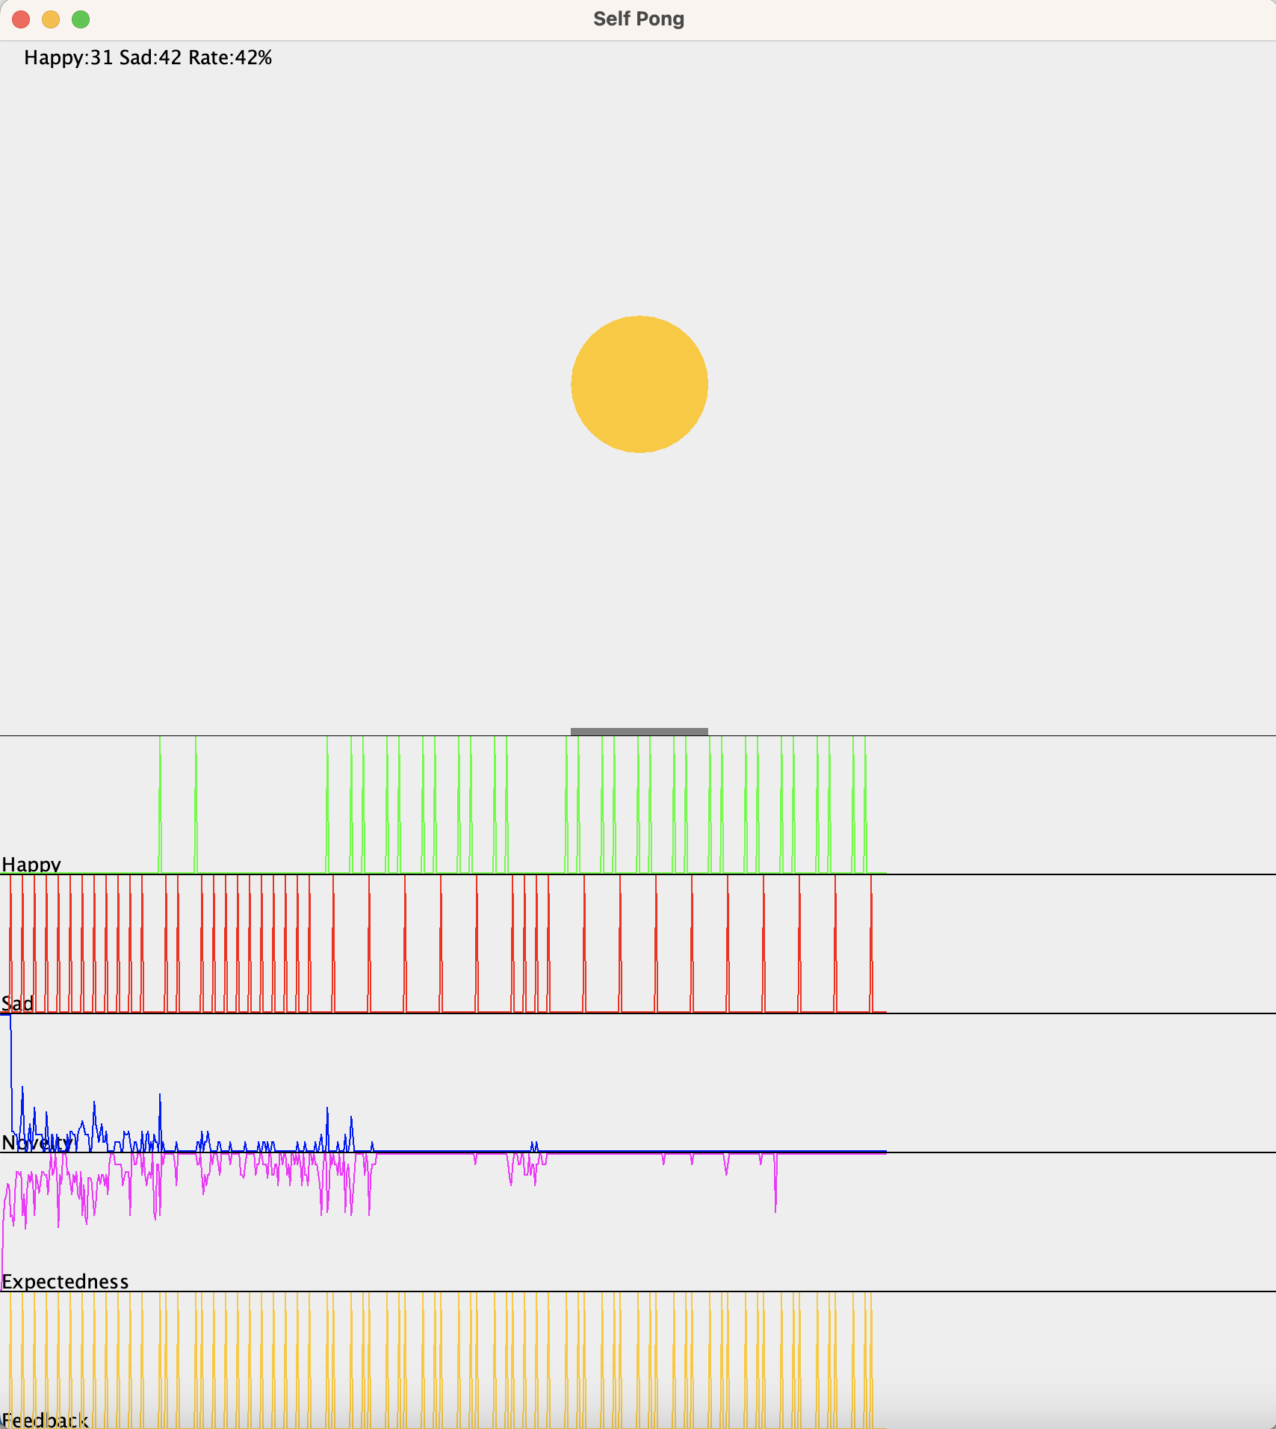
Cognitive architecture of value-based experiential learning (“Ping-Pong”)
Sad(t)
Happy(t)
Left(t)
Stay(t)
Right(t)
Agent
Comp-
ressor
Xball(t)
Yball(t)
Xracket(t)
Sad(t)
Happy(t)
Predicates
Base Values
Pre-
dictor
Models
Evidence Log
Decider
Action Log
Move(t)
Anton Kolonin & Vladimir Kryukov,
Computational Concept of the Psyche,
Neuroinformatics-2025
https://arxiv.org/pdf/2509.07009

Slide 16
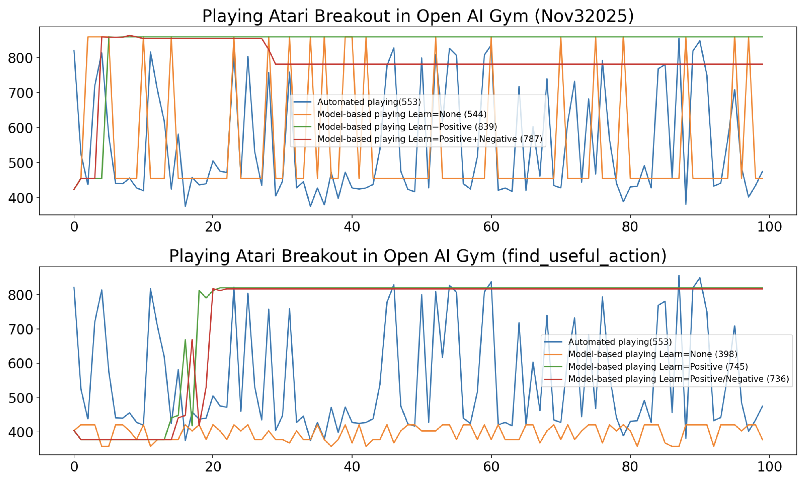
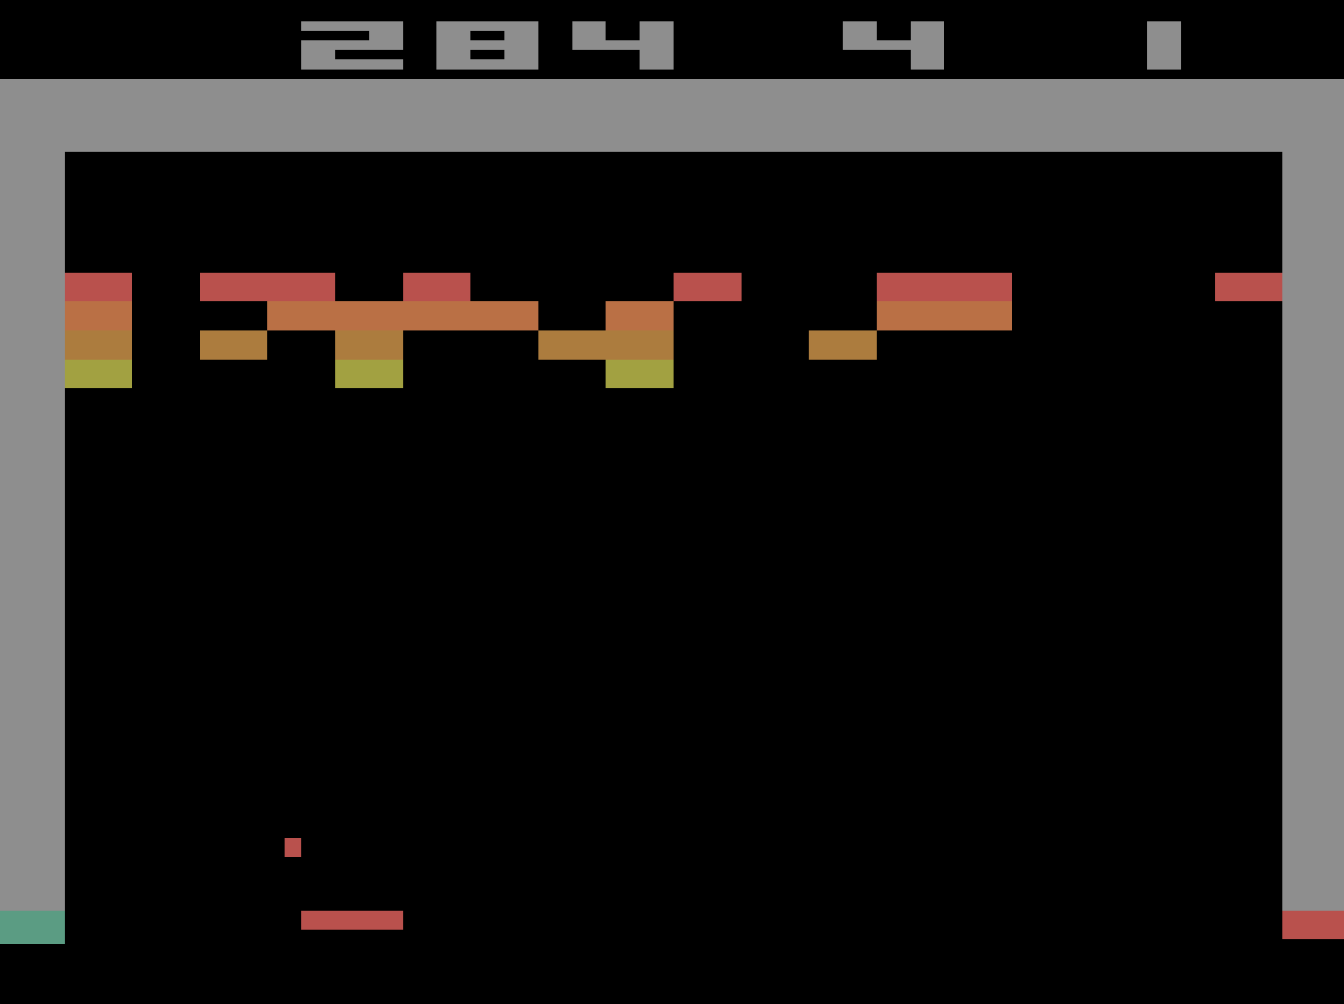
Imitation learning – decision making on “pre-trained” model (“ Breakout”)
864

Slide 17
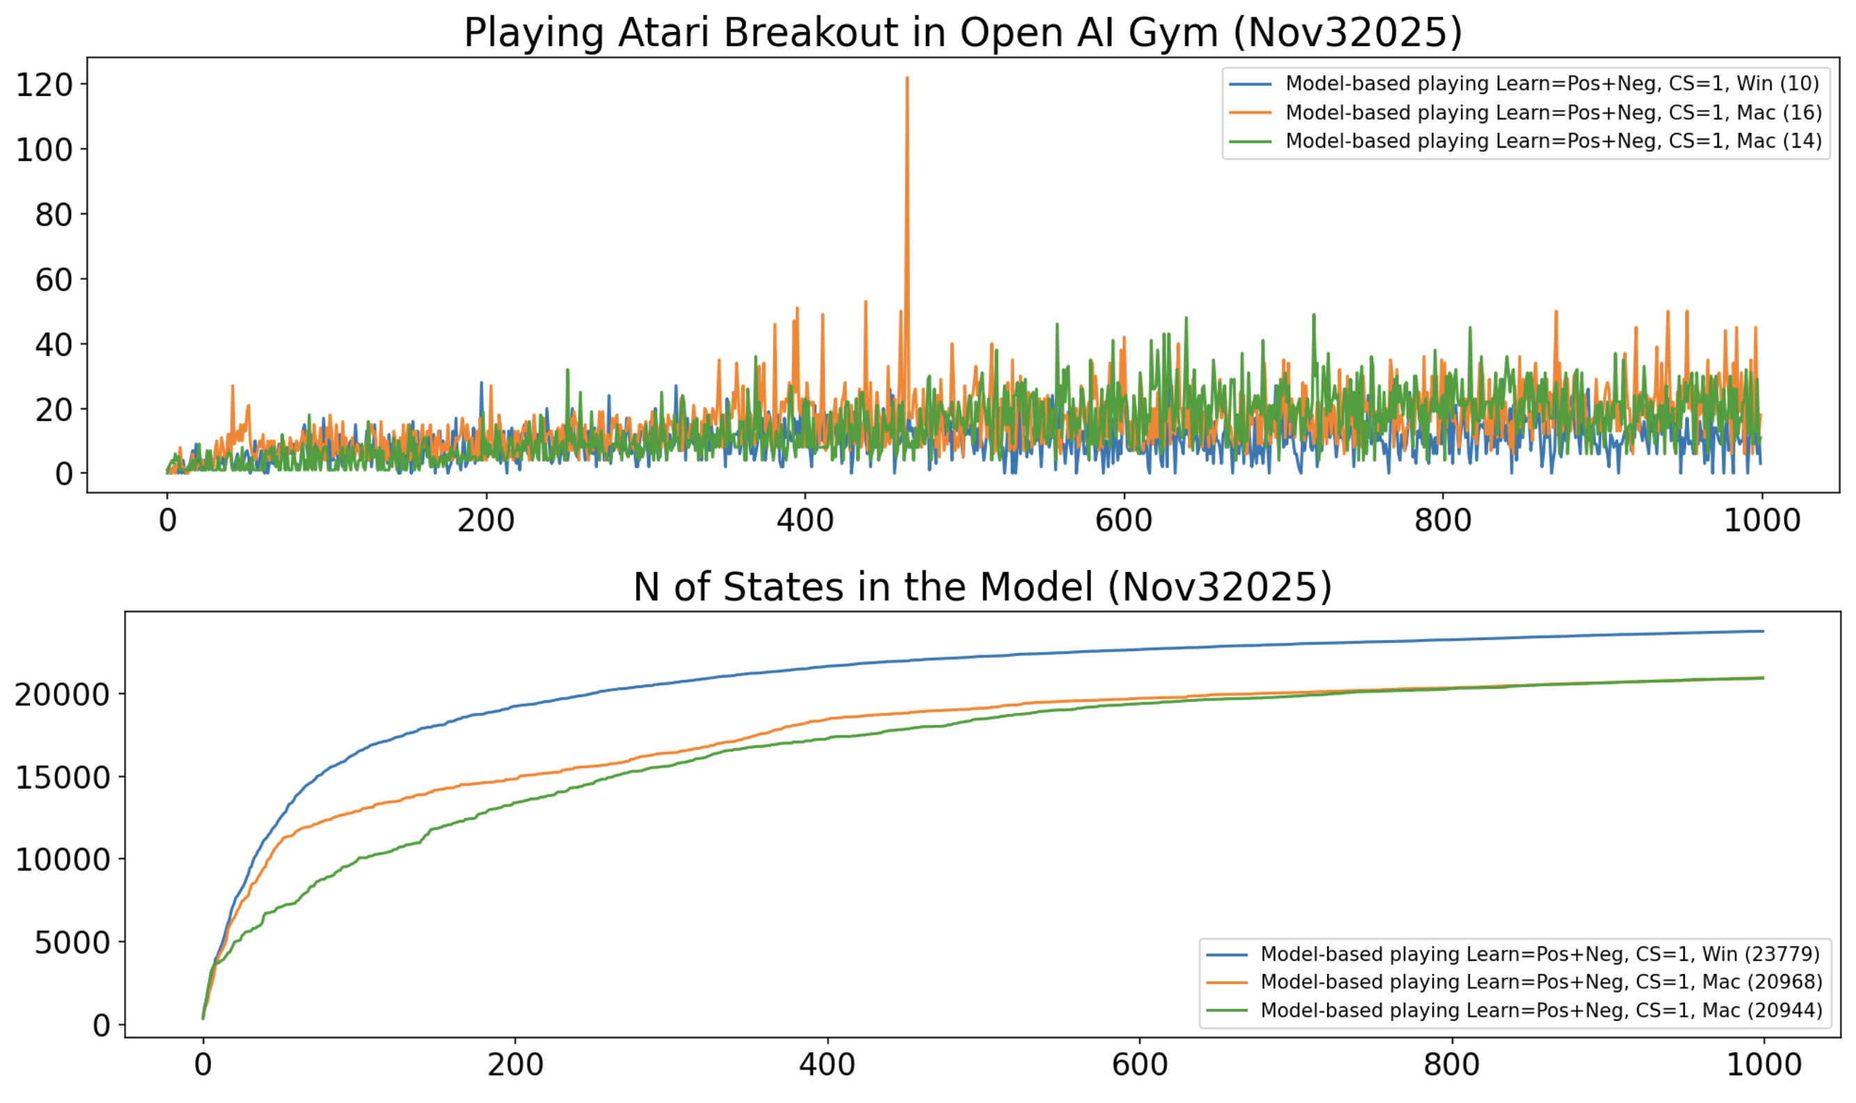
Reinforcement learning – experiential learning & decision making (“Breakout”)
Average human level
Average human level
U({sτ}τ∈{-Τ,-1}​,s’0) = L( x⋅(yt - yt-1), (s’t - st), E(at-1) )
s’t=argmaxs(U({sτ}τ∈{t-Τ,t-1}​,s’t),P({sτ}τ∈{t-Τ,t-1}​,s’t) )
T=1
U({sτ}τ∈{-Τ,-1}​,s’0) = L( x⋅(yt - yt-1), (s’t - st), E(at-1) )
s’t=argmaxs(U({sτ}τ∈{t-Τ,t-1}​,s’t),P({sτ}τ∈{t-Τ,t-1}​,s’t) )
T=1

Slide 18
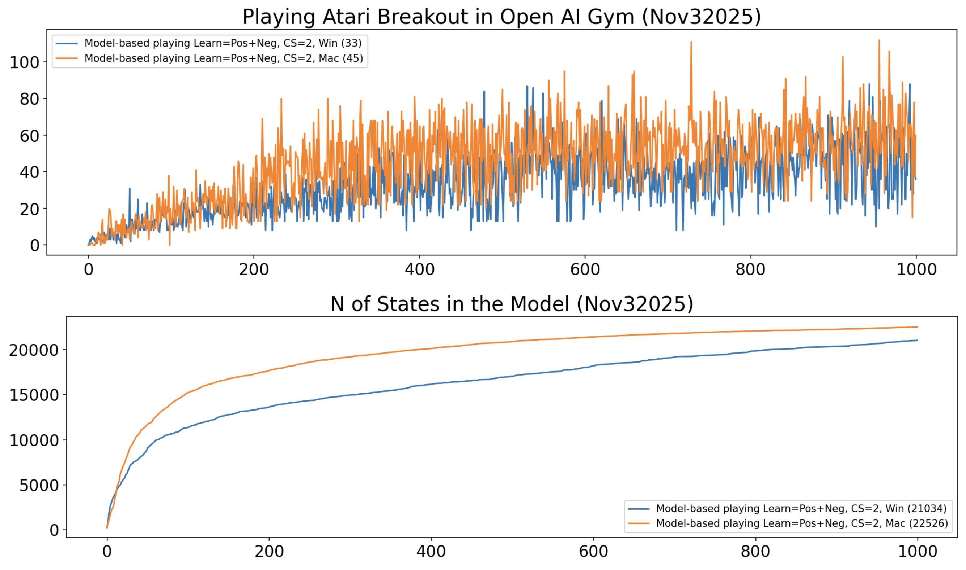
Reinforcement learning – experiential learning & decision making (“Breakout”)
Average human level
U({sτ}τ∈{-Τ,-1}​,s’0) = L( x⋅(yt - yt-1), (s’t - st), E(at-1) )
s’t=argmaxs(U({sτ}τ∈{t-Τ,t-1}​,s’t),P({sτ}τ∈{t-Τ,t-1}​,s’t) )
T=2, Similarity=0.99

Slide 19
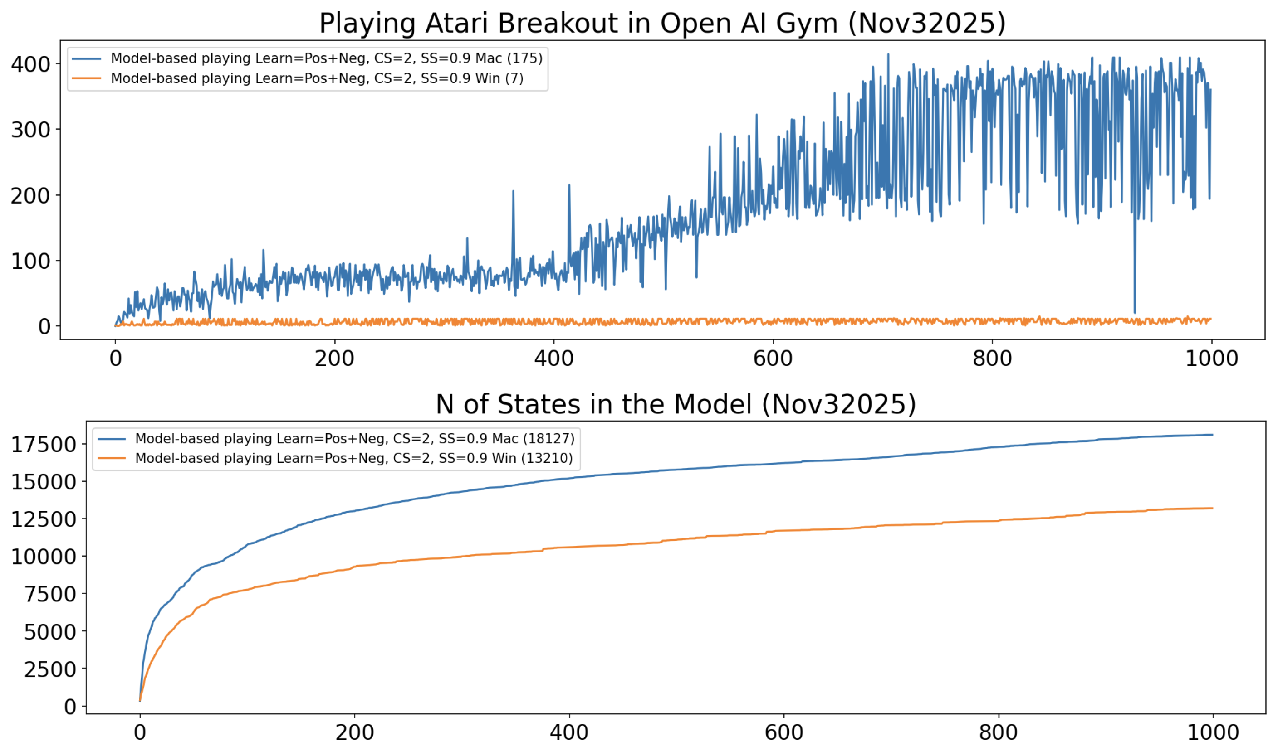
Reinforcement learning – experiential learning & decision making (“Breakout”)
Top DQN level
Average DQN level
Average human level
U({sτ}τ∈{-Τ,-1}​,s’0) = L( x⋅(yt - yt-1), (s’t - st), E(at-1) )
s’t=argmaxs(U({sτ}τ∈{t-Τ,t-1}​,s’t),P({sτ}τ∈{t-Τ,t-1}​,s’t) )
T=2, Similarity=0.9

Slide 20


Thank you for attention! Questions?
Anton Kolonin
akolonin@aigents.com
Telegram/GitHub: akolonin
Workshop recording
on the subject
Anton Kolonin & Vladimir Kryukov, Computational Concept of the Psyche, Neuroinformatics-2025

